Slide 1
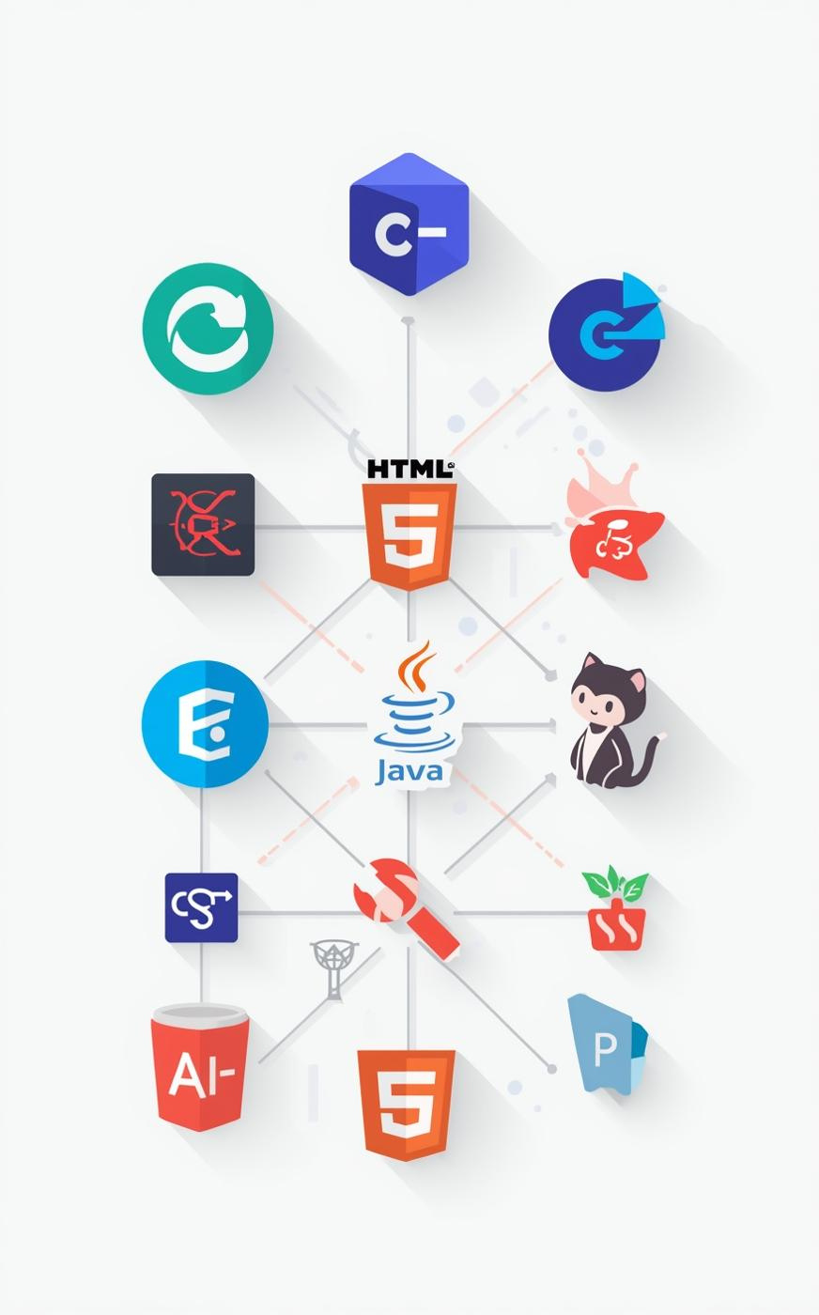

Full Stack Development Tools
Title: Full Stack Development Tools Overview Subtitle: Postman | Eclipse | Java | HTML | CSS | GitHub | MySQL Presented by: Sanjana.D and Sinchana.D Institute: City Engineering College Date: 08-10-2025

Slide 2

Introduction to Full Stack Development
Understanding Frontend and Backend
Full stack development encompasses the complete web application lifecycle, integrating both frontend and backend technologies. This enables developers to build and manage both user interfaces and server-side logic effectively.

Slide 3
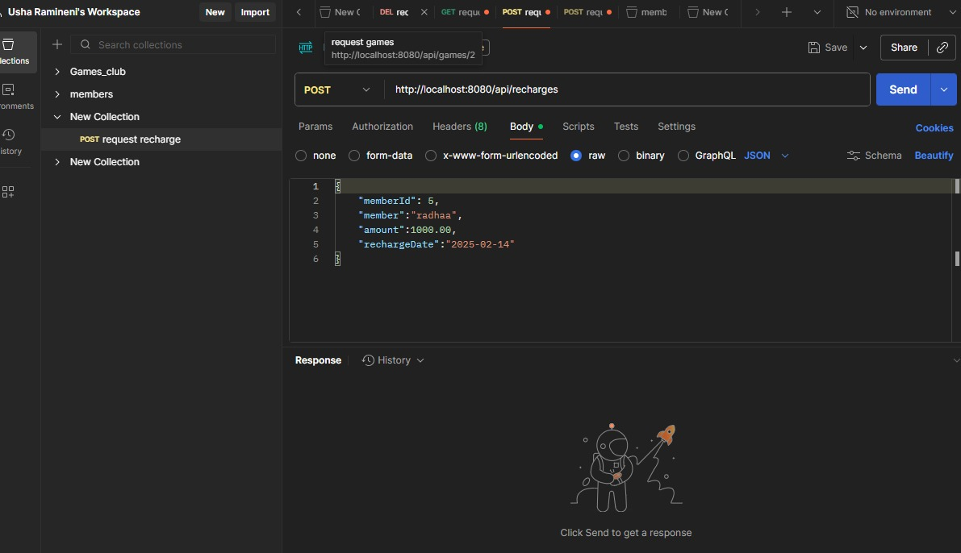
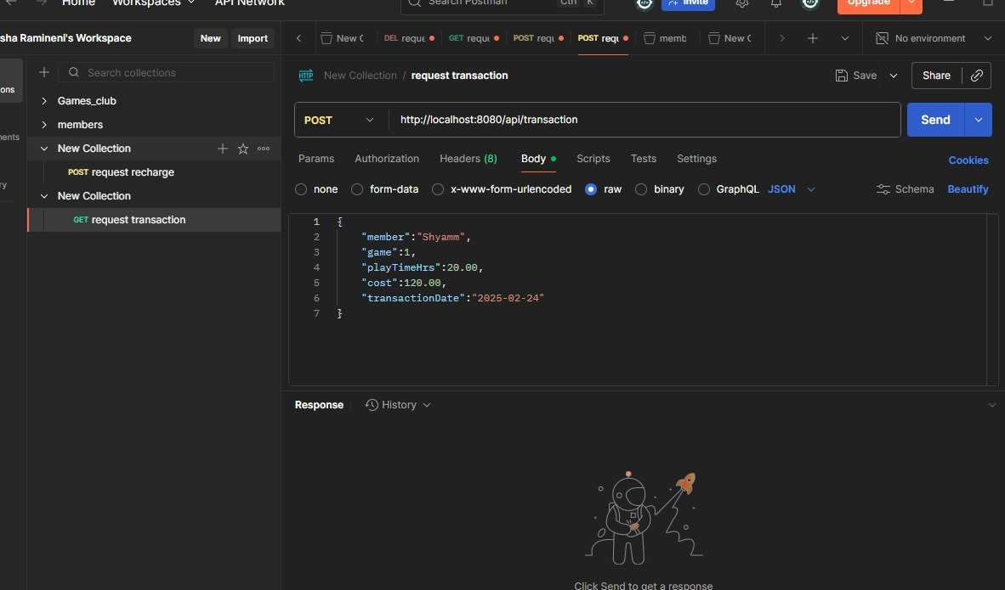
Postman for API Testing
Essential Tool Overview
Postman is a powerful tool for API testing and debugging, enabling developers to create and automate test cases while efficiently managing collections and environments.

Slide 4
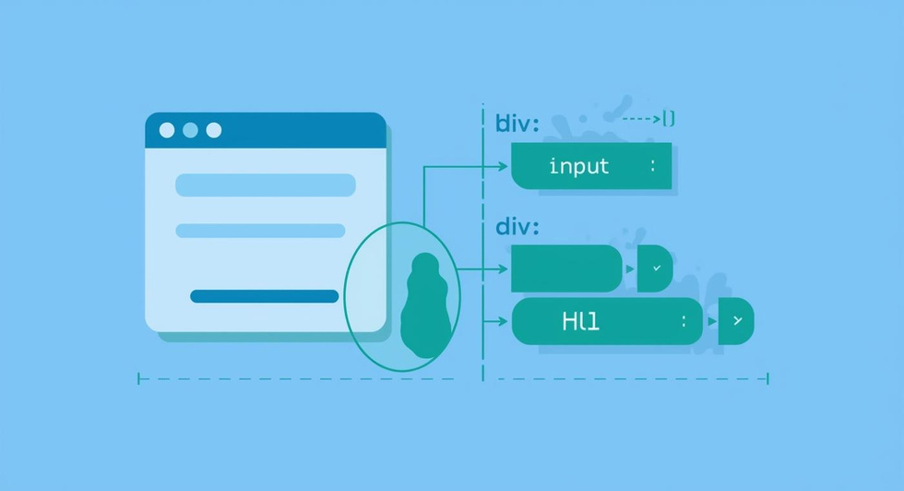
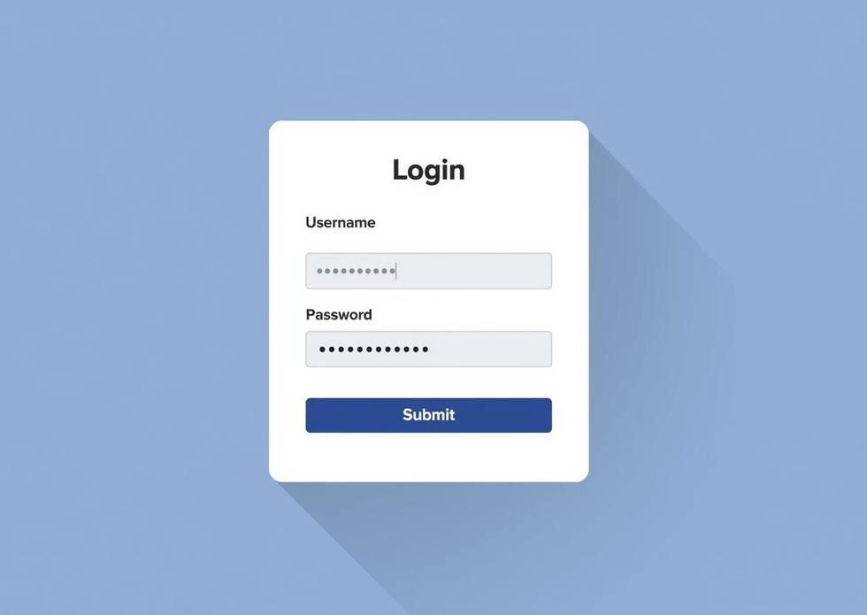
HTML: Structuring Web Pages
Understanding HTML Basics
HTML, or HyperText Markup Language, is the fundamental building block for web pages, providing structure and layout through essential tags like and .

Slide 5
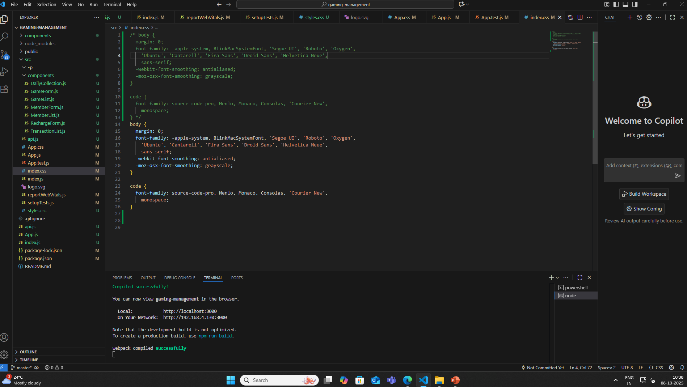
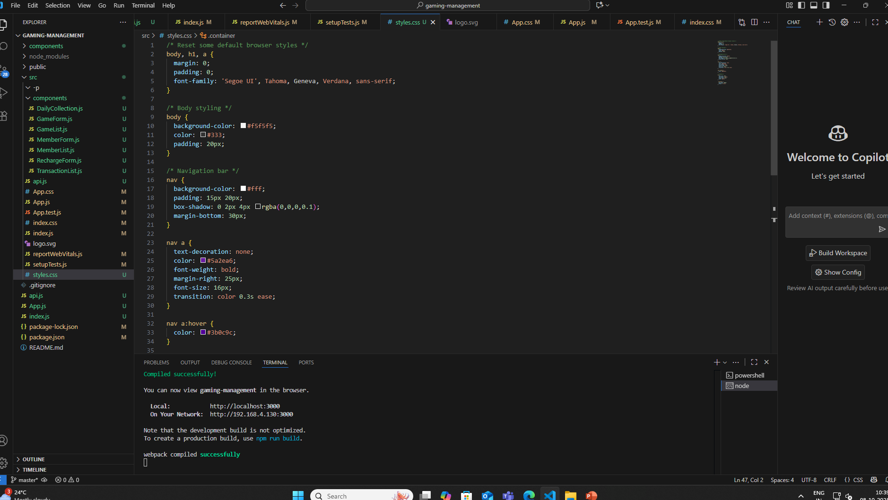
CSS Styling Techniques
Enhancing UI/UX Design
CSS is essential for styling HTML pages, improving the visual appeal and overall user experience through layout, colors, and design elements that engage users effectively.

Slide 6
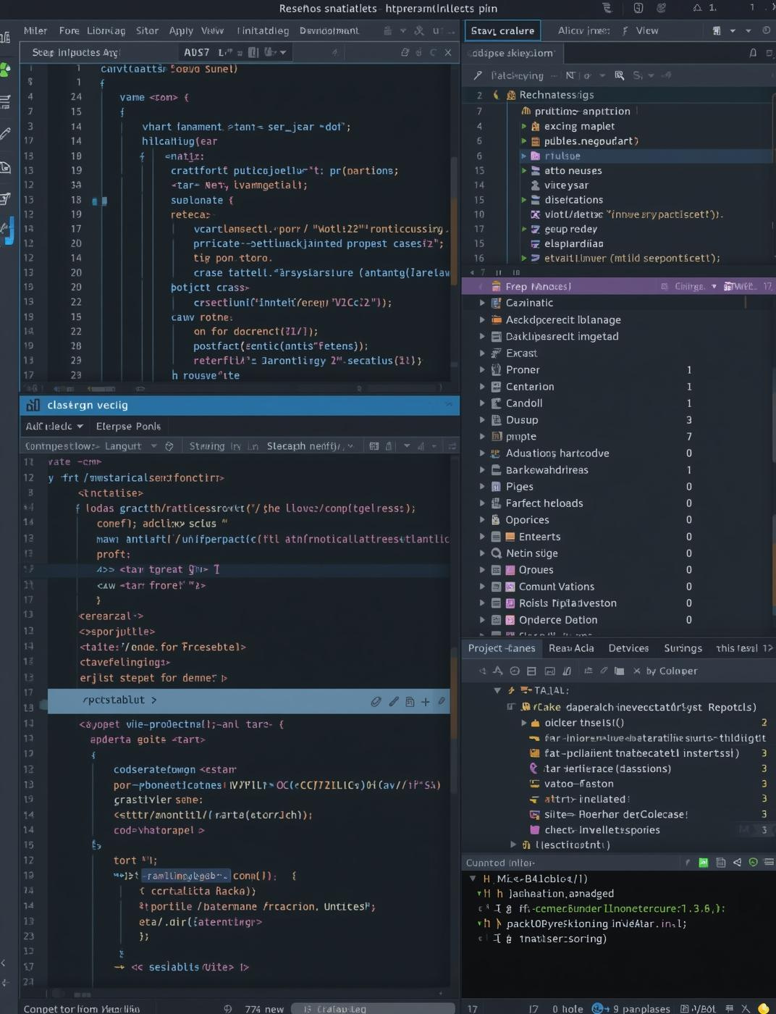
Eclipse IDE
Java Development Environment
Eclipse IDE is a powerful tool for Java development, offering advanced features like code editing, debugging, and build automation, enhancing productivity throughout the development lifecycle.

Slide 7
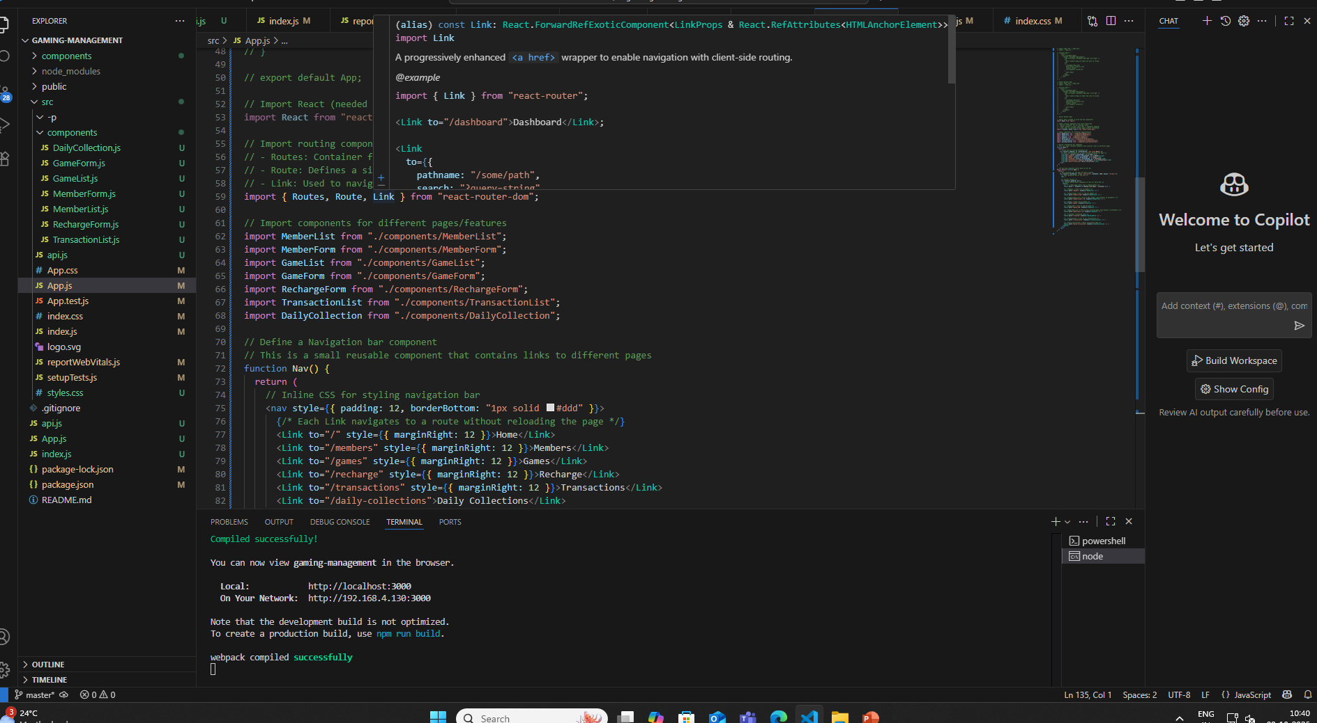
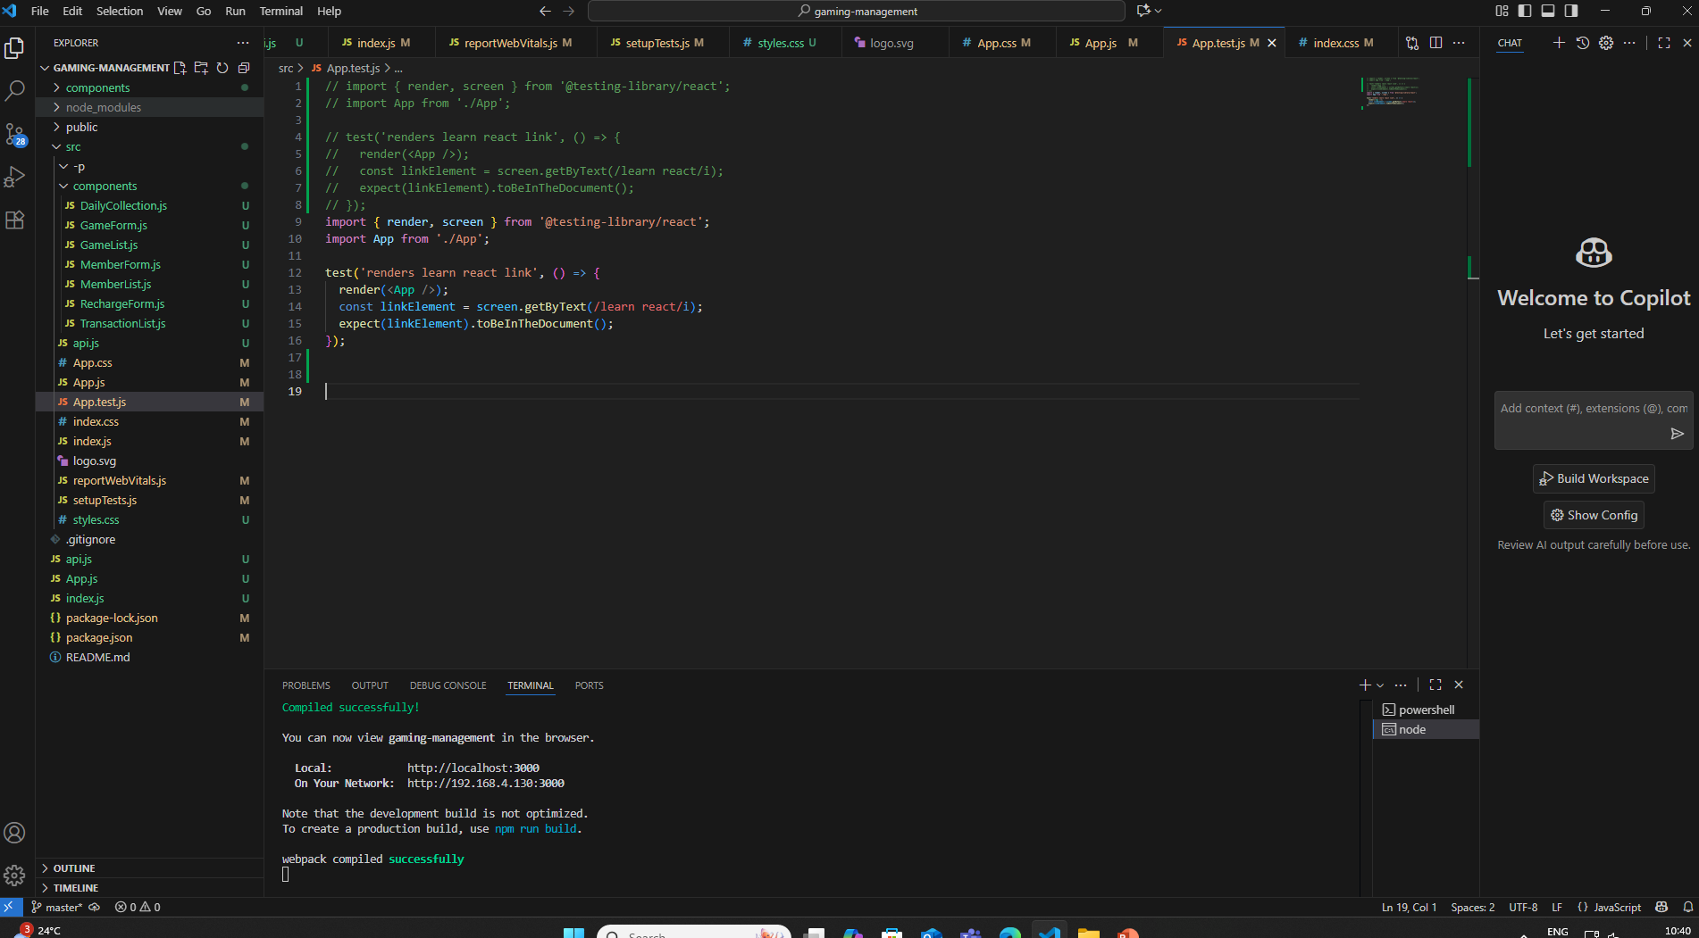
Java Object-Oriented Programming
Understanding Java Basics
Java is a powerful, object-oriented programming language that emphasizes code reusability and modularity, making it ideal for complex applications and full stack development.

Slide 8
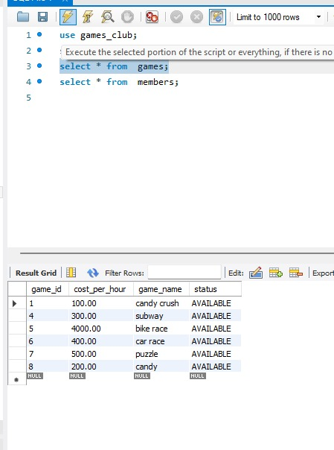
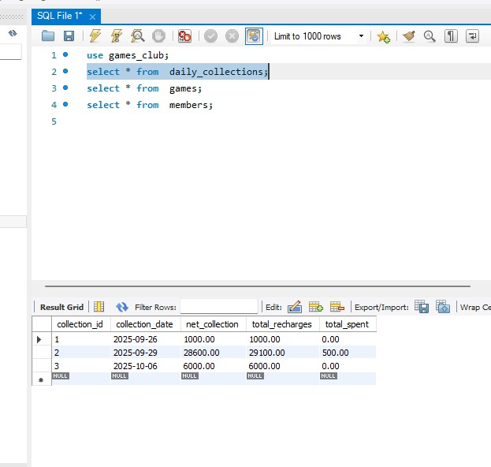
MySQL: Database Management
Understanding Relational Databases
MySQL is an essential relational database management system, enabling efficient data storage and retrieval, integral for full stack development projects that require robust data management.

Slide 9
GitHub Collaboration Tools
Version Control for Teamwork
CI/CD Integration
Version Tracking
Branching and Merging
GitHub supports Continuous Integration and Continuous Deployment (CI/CD), facilitating automated testing and deployment processes, which enhance the quality and speed of software delivery while ensuring consistency across environments.
GitHub provides a robust version tracking system that enables developers to monitor changes to the source code efficiently, ensuring a reliable history of project development and modifications.
With GitHub's branching and merging features, teams can work on separate features concurrently, reducing conflicts and allowing for smoother integration of new code into the main project line.

Slide 10
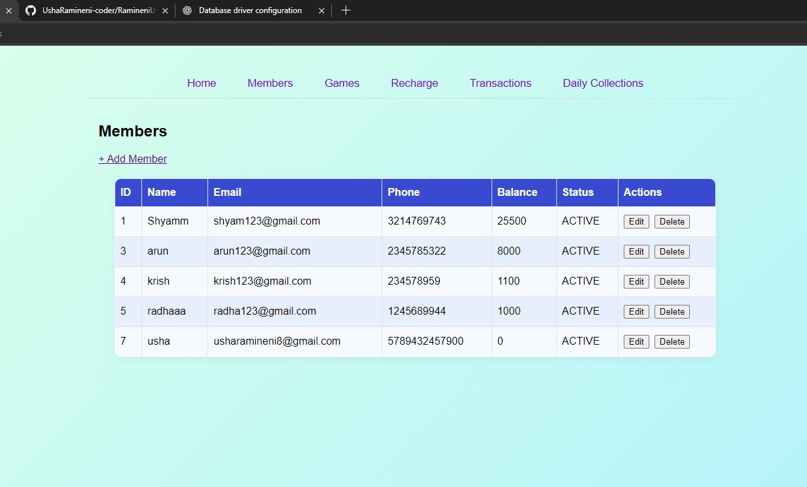
Summary
Recap of Full Stack Development Tools
Postman: API testing and debugging tool
Eclipse: Java development environment
Java: Object-oriented programming language
HTML: Structure and layout language
CSS: Visual styling for web pages
GitHub: Version control system

